Slide 1
Isotropy vs Storm-time Parameters Update

Slide 2
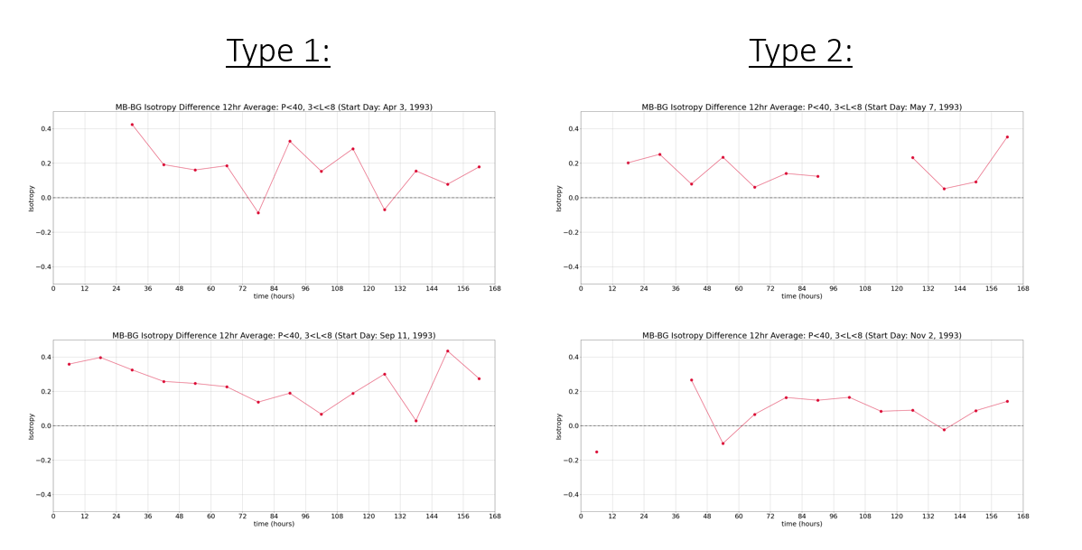
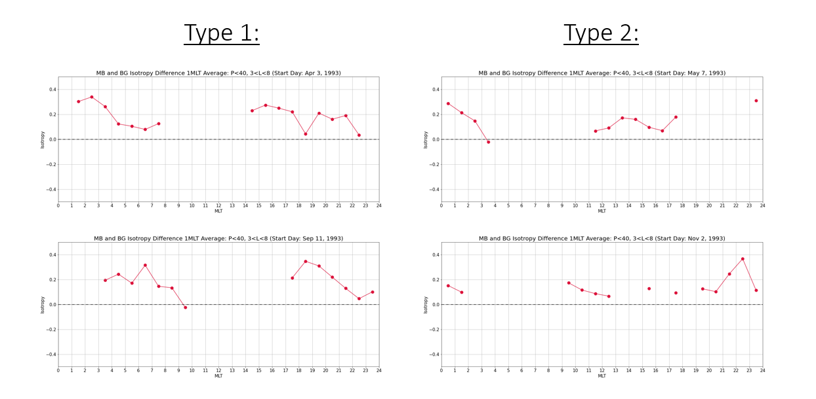
Based on inconclusive results, the 4-storm isotropy vs time analysis has been scrapped.
Iso Diff vs Time Iso Diff vs MLT

Slide 3
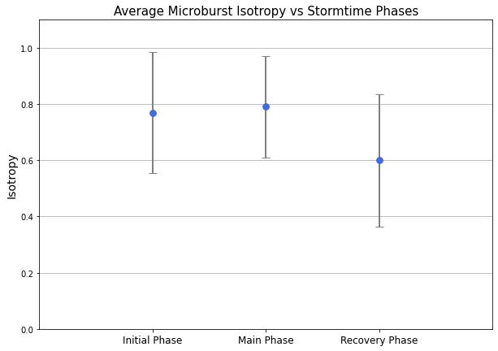
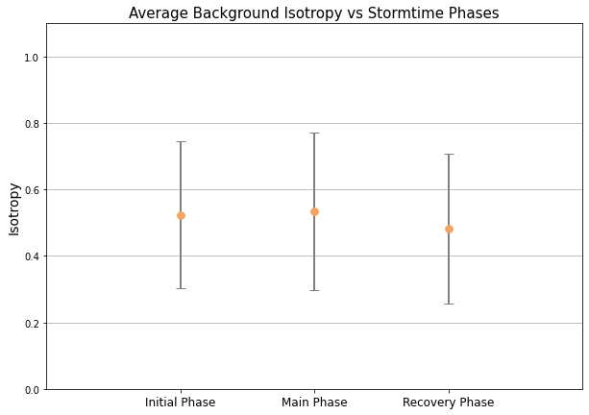
New Results: Average Isotropy vs Storm-time phases

Slide 4
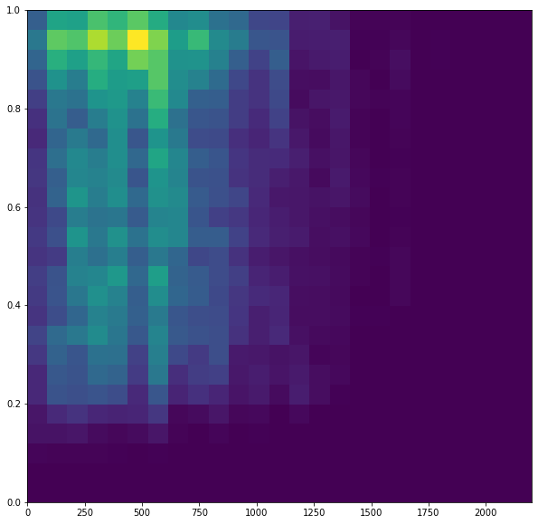
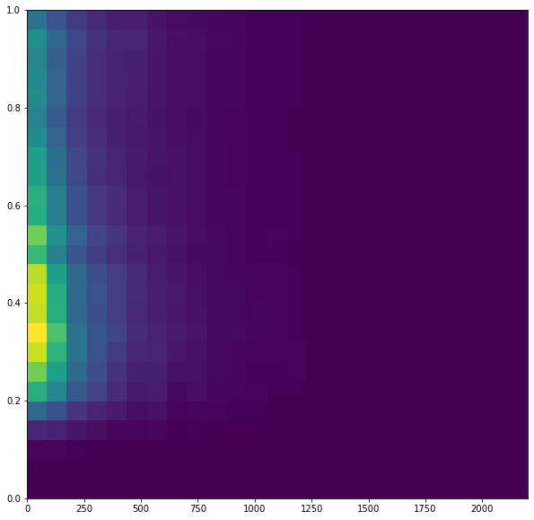
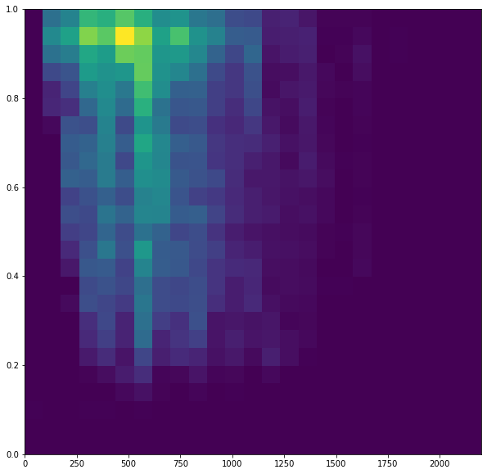
New Results*: Average Isotropy vs AE Indices (2D histograms)
*Note: Planning to plot average isotropy vs AE indices (similar to previous slide) for final paper figures
Microbursts Background Normalized Difference
Isotropy
AE Index (nT)
AE Index (nT)
AE Index (nT)

